Slide 1
COMP 2310 Data Structures and Algorithms
Lecture 5
Linked Lists

Slide 2
Dynamic Data Structures
Storage for all elements of a static array is allocated together at compile time as one fixed block of memory.
If insertions and deletions are frequent, array implementation is not a good choice because of the need for several shift operations.
Shifts at run time are costly (Take time).
What can be done to overcome disadvantages of the static array implementations?
The answer is dynamic data structures whose sizes can change at run time.
As the first example we consider linked lists structures.

Slide 3

Static and Dynamic Data Structures
Memory allocation: Compile time, fixed
Memory allocation: Run time, dynamic

Slide 4
#include <iostream>
using namespace std;
int main() {
int array[6];
for(int i=0;i<6;i++) {
array[i] = i;
cout << array[i] << " ";
}
cout<<endl; // changing line
for(int i=0; i<6; i++) {
array[i] = 15;
cout << array[i] << " ";
}
return 0;
}
Output :
0 1 2 3 4 5
15 15 15 15 15

Slide 5
Implementing Dynamic Structures Pointers
A pointer contains the location, or address in memory, of a memory cell
Initially undefined, but not NULL
A statically allocated pointer declaration
int *p;
A dynamically allocated pointer variable
p = new int;

Slide 6
Pointers
To get a pointer to point a memory cell, first we declare it to be a pointer variable of a specific type:
int *p; (points to a memory cell that contains an integer)
int x; (integer value in a cell)
Memory for p and x is allocated at compilation time (before execution).
Notes:
6

Slide 7
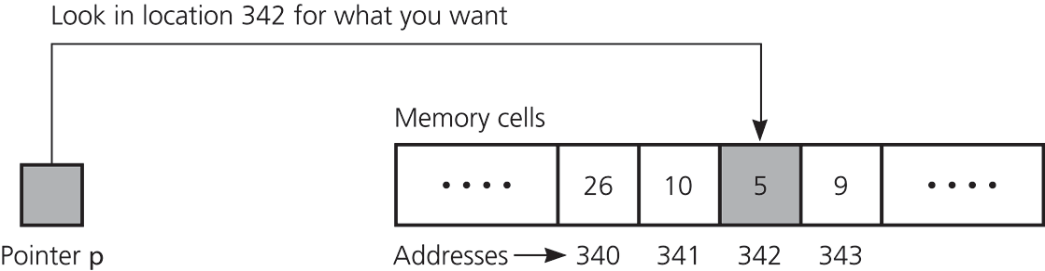
Pointers
The expression, *p, denotes the memory cell to which p points
The & address-of operator places the address of a variable into a pointer variable
p = &x;
Pointer p points to the memory cell that contains x=5, whose adress is 342.

Slide 8
Pointers
We can place the address of variable x into p
→ Pointer p points to the memory cell that holds x.
*p: the content of memory cell which is pointed by p.
→ The value inside memory cell is *p which refers to x.
p=&x;
?
p x or *p
Notes:
8

Slide 9
Pointers
We can store a value in the memory cell which is pointed by p as follows:
int *p;
*p=7;
(or x=7;)
7
p x or *p
The delete or free operator returns dynamically allocated memory to the system for reuse, and leaves the variable undefined:
delete p;
free(p);
Notes:
9

Slide 10
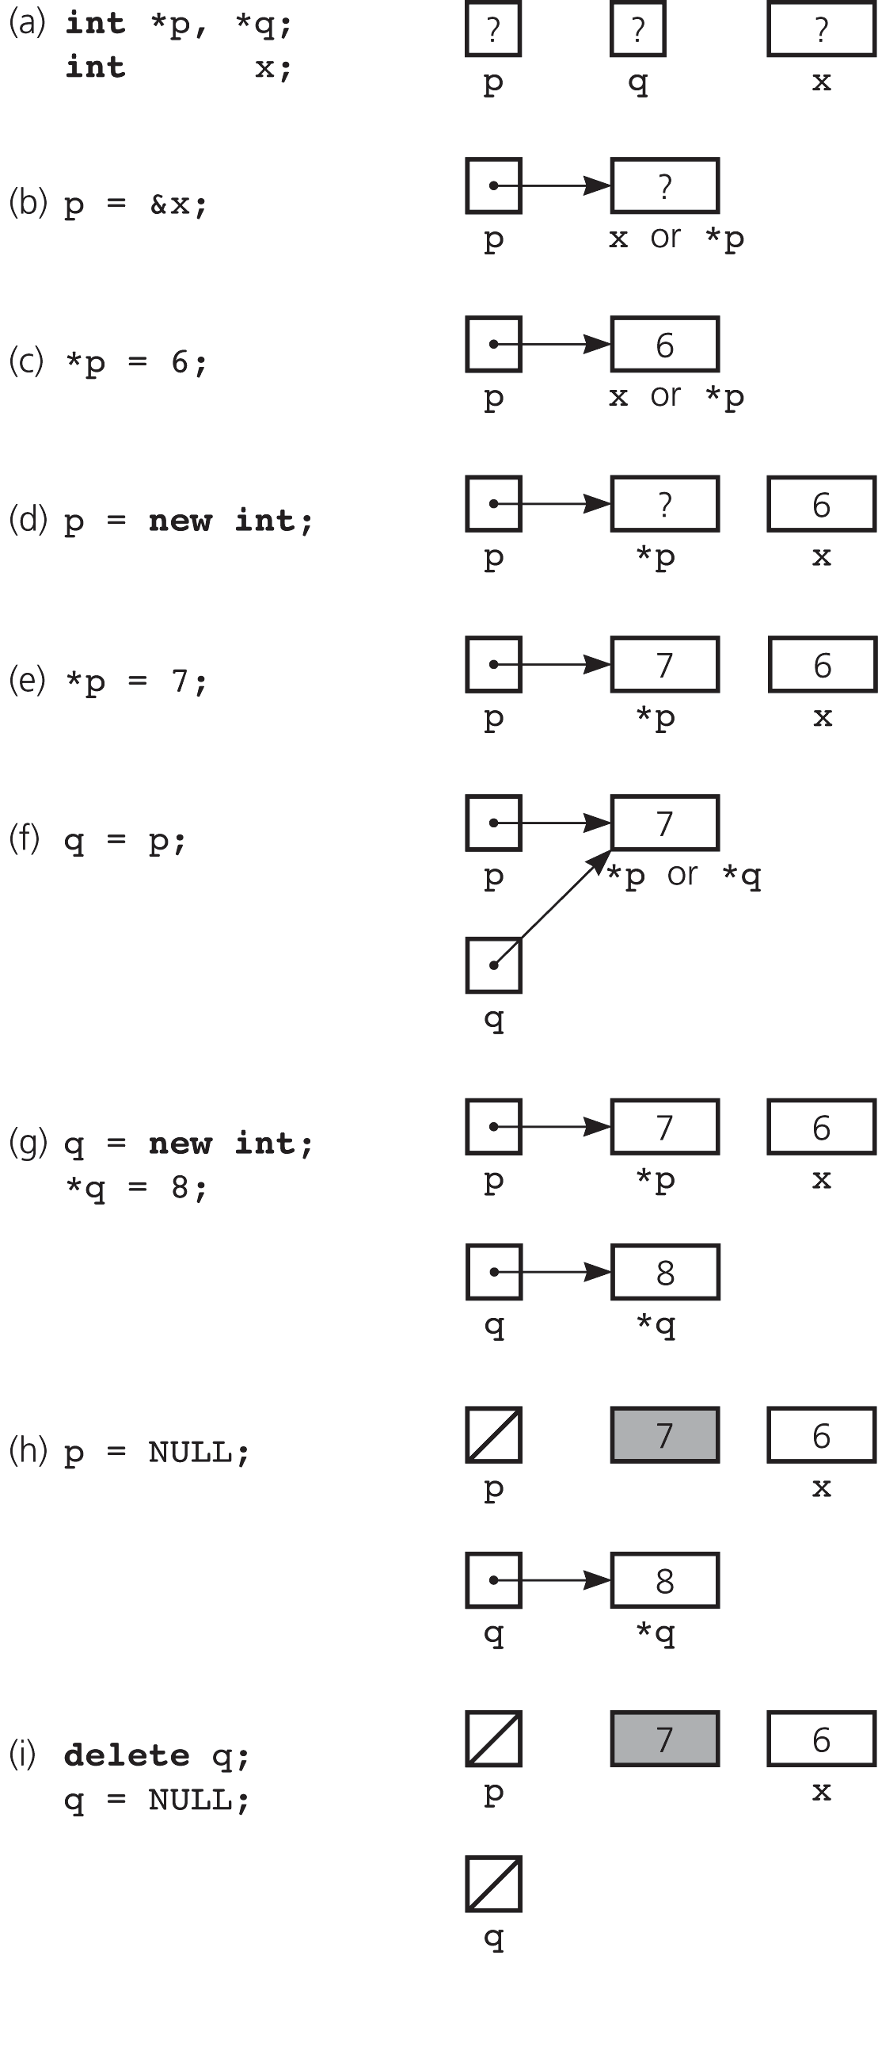
Pointers: Examples
(a) declaring pointer variables; (b) pointing to statically allocating memory; (c) assigning a value;
(d) allocating memory dynamically; (e) assigning a value

Slide 11
Pointers: Examples
(f) copying a pointer;
(g) allocating memory dynamically
and assigning a value;
(h) assigning NULL to a pointer
variable;
(i) deallocating memory

Slide 12
#include <iostream>
using namespace std;
int main() {
int num = 11;
int * pNum; //Declares a pointer to an integer
pNum = &num; //assign the address of num to pointer pNum
cout << pNum << endl; // Print content of pNum,an internal address
cout << &num << endl; // Print address of num
cout << *pNum << endl; // Print value pointed to by pNum
cout << num << endl; // Print value of num
*pNum = 22; //Assign another value pointed to by pNum
cout << pNum << endl;
cout << &num << endl;
cout << *pNum << endl;
cout << num << endl;
cout << &pNum << endl;
Return 0;
}

Slide 13
Program output
0x23fe4c (=internal address of pNum )
0x23fe4c
11 (= *pnum)
11 (= num )
0x23fe4c
0x23fe4c
22
22
0x23fe40

Slide 14
Linked List Structure: Properties
Linked lists are common and dynamic alternatives to arrays in list implementations.
There is no need to define an initial size: Size can vary dynamically by allocating and deallocating memory at run time.
→Linked lists are linear data structures which can automatically grow or shrink in size.
Insertion and deletion of elements is quicker with linked lists than with arrays.

Slide 15
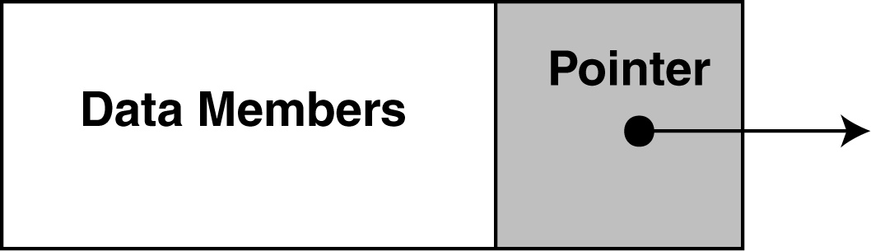
Simple Linked Lists
Linked lists are implemented using pointers:
→Each element (node) points to next element.
If we know where an element is, we can determine its successor which can be anywhere in the memory.
This allows us to insert an element without shifting data.
It also allows us to change the size of the list dynamically.
→Dynamic memory allocation: Memory allocation at run time.
In a singly linked list the tail pointer is usually set to NULL.
Notes:
15

Slide 16
Linked List Structure: Properties
The Elements of a linked list are called nodes of the list.
Each node contains a “data field” of some type and a "next" (or link) field, which is a pointer to link one node to the next node.
The data part contains necessary information about the items of the list, the next part contains the address of the next node.
In a linked list, it is easy to insert and delete elements at run time.

Slide 17

Head of the List
Head: A pointer (reference) to the First node of the list.
Head holds the memory address of the first node
A linked list uses linked allocation, and therefore each node may be stored anywhere in memory.
First node

Slide 18
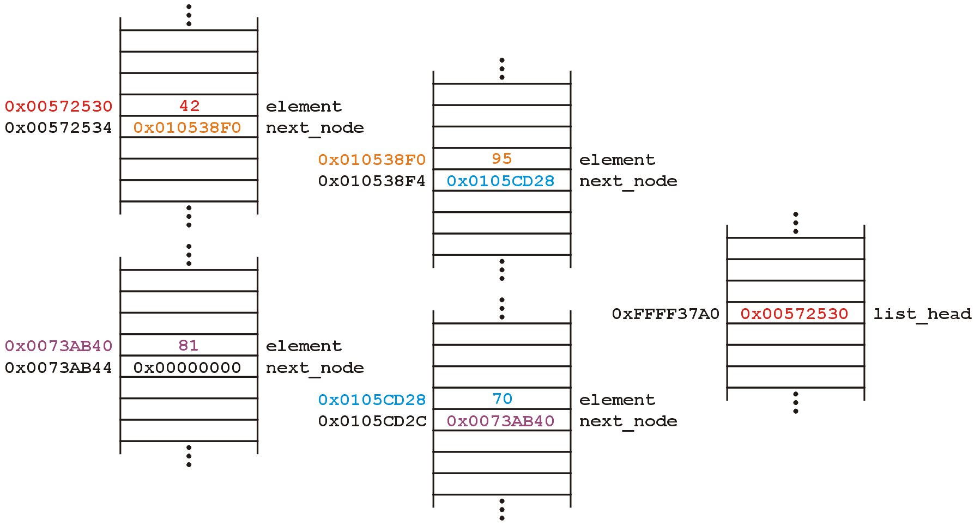
Memory Structure of a Linked List
Suppose we want a linked list to store these values:
42 95 70 81
Memory allocation will be as follows :
Linked List Object
0xFFFF37A0

Slide 19
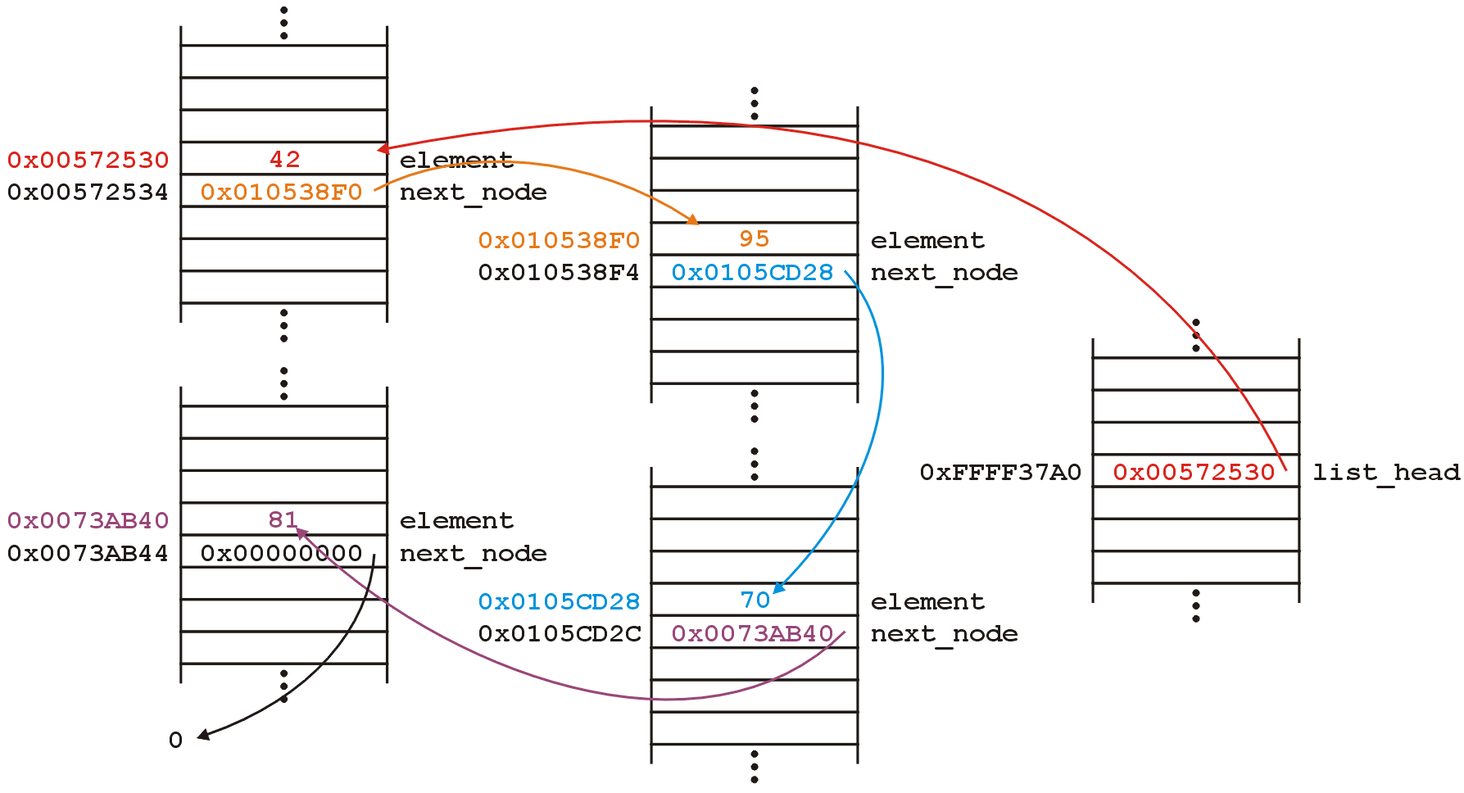
Memory Structure
The next_node pointers store the addresses of the next node in the list. L is the list object whose start is list_head
L 0xFFFF37A0

Slide 20
Definition of a Linked List
A linked list is a sequence of elements (nodes) where every element is linked to the next one.
The start address of the list is given by the head pointer.
A tail pointer may also be used to hold last node address.
Graphically:
data
data
data
data
head_ptr
tail_ptr NULL

Slide 21
Examples of Linked Lists: A list of Numbers
A list of numbers : 10, 8, 6, 8, 2
A linked list of integers can be used to hold a dynamic list of numbers.
→Dynamic: numbers can be added or removed at run time without worrying about their physical addresses.
10
8
6
8
2
head_ptr
tail_ptr

Slide 22
Examples of Linked Lists Sequence (list) of four items < a₁,a₂ ,a₃ ,a₄ > :
Head_ptr
Tail_ptr
a₁
a₂
a₃
a₄
A waiting line of customers: John, Mary, Dan, Sue from the head to the tail of the line
A linked list of strings can represent this waiting line:
John
Mary
Dan
Sue
tail_ptr
head_ptr

Slide 23
Operations on Linked Lists
Insert a new item: Options
At the head of the list, or
At the tail of the list, or
Inside the list, in some designated position
Search for an item in the list
The item can be specified by position, or by data value
Delete an item from the list
Search for and locate the item, then remove the item, and finally adjust the surrounding pointers
size()
isEmpty()
isFull()

Slide 24
Insert / Delete Operations
Insertion into a linked list has three special cases:
Inserting a new node before the first (to the very beginning of the list)
After the last (to the very end of the list).
In other cases, new node is inserted inside the list and so, has a predecessor and successor in the list.
The operator NEW creates a new and empty node whose structure should be known. The link field of a new node is NULL.
For deletion of a node from the list we also have the same cases: Delete the first, the last or delete a node inside the list.

Slide 25
Insert – at the Head
A /
Insert data A into the new node(create): newPtr
List before insertion:
After insertion to head:
data
data
data
data
head_ptr
tail_ptr
A
data
data
data
data
tail_ptr
head_ptr
The link value in the new node = old first node
The new value of head_ptr = newPtr

Slide 26
Insert – at the Tail
A
Insert a new data A. Call new: newPtr
List before insertion
After insertion to tail:
data
data
data
data
head_ptr
tail_ptr
data
data
data
data
A
tail_ptr
head_ptr
The link value in the new node = NULL
The link value of the old last node = newPtr

Slide 27
Insert – inside the List
data
Insert a new data A. Call new: newPtr
List before insertion:
After insertion in 3rd position:
data
data
data
data
head_ptr
tail_ptr
data
data
A
data
data
tail_ptr
head_ptr
The link-value in the new node = link-value of 2nd item
The new link-value of 2nd node = newPtr

Slide 28
Delete – the First Node
List before deletion:
List after deletion of the First item:
data
data
data
data
data
head_ptr
tail_ptr
data
data
data
data
data
head_ptr
tail_ptr
The new value of head_ptr = link-value of the old first node
The old first node is deleted and its memory returned

Slide 29
Delete – the Tail Node
List before deletion:
List after deletion of the tail node:
data
data
data
data
data
head_ptr
tail_ptr
data
data
data
data
data
head_ptr
tail_ptr
New value of tail_ptr = link-value of the node before the tail
New link-value of new last node = NULL.

Slide 30
Delete – an inside Node
List before deletion:
List after deletion of the 2nd node:
data
data
data
data
data
head_ptr
tail_ptr
data
data
data
data
data
head_ptr
tail_ptr
New link-value of the node located before the deleted one
= the link-value of the deleted node

Slide 31
Simple Linked Lists: Summary
A linked structure is a collection of nodes storing data and links to other nodes.
In this way, nodes can be located anywhere in the memory
Passing from one node to another is accomplished by storing the address of another node in the linked structure.

Slide 32
Pointers to structures
Like any other type, structures can be pointed by its own type of pointers
struct product
{
int weight;
double price;
};
product apple; //Declare apple object
product *pt_apple; //Declare a pointer for product
pt_apple = &apple; //Pointer now holds the address of //apple object
Notes:
32

Slide 33
Implementation: Pointer-Based Linked Lists
A node in a linked list is usually a struct, which can have one of its members as a pointer to another structure of the same type.
struct Node
{
int data
Node *next;
};
A node is dynamically allocated
Node *p; //Declare
p = new Node; //Create p
data

Slide 34
Pointer Based Linked Lists
In C, C++, the statement
p->data;
defines that data content of the node which is pointed by p.
In algorithmic notation we use data[p] for p->data.
How do we get the beginning of the list?
We declare an additional pointer (head pointer) to point to the first node of the linked list.
head is an external pointer (different than next)
head always exists even when there are no nodes on the list.
Notes:
34

Slide 35
Pointer Based Linked Lists
Creating head whose type is node:
Node *head;
To initialize
head=NULL;
If head is NULL then the list is empty.
Notes:
35

Slide 36
Pointer Based Linked Lists
The statement
Node *p; (or Node* p)
declares a pointer variabe which points to another variable of type node. (Its value is undefined.)
The statement
p = new node;
allocates a new node which is pointed by p.
Here is the C++ statement:
new_ptr = new node;
The statement creates a new node, and points the local variable new_ptr at this newly-created node.
Notes:
36

Slide 37
Algorithms: Displaying the Contents of a Linked List
Suppose that we have the following list and we want to print its content.
head
.....
data=5
data=9
data=15
next
next
NULL
Notes:
37

Slide 38
Displaying Node Contents of a Linked List
//Prints data contents of all nodes from first to last
DisplayList( L )
current ← head [ L] // head is a pointer that points // to the first node of L
while current ≠ NULL do
print data[current ]
current ← next [current] //Continue until NULL
Notes:
38

Slide 39
Searching for a Node
We want to find the node whose data value is k
We perform a simple linear search in the list and return a pointer to this node.
At each node, a comparison between the data member and k is performed.
If no object with the given value found in the list then NULL is returned.

Slide 40
Search Algorithm
//Performs a search for the node whose data value is k
SearchList( L, k )
current ← head [L]
while current ≠ NULL and data[current]≠ k //search for the node
do current ← next [current]
return current // Returns the pointer to the node containing k
// or NULL
Notes:
40

Slide 41
Inserting a Node to the Front of a List
Assume that the new node is x and its fields have been set.
Given the list L and new_node x, insert x onto the front as the first node.
The algorithm checks for an empty node, if this is the case the head points to x .
If the list is not empty, the next pointer of x is set to the previous first node of the list and x becomes the new first node .

Slide 42
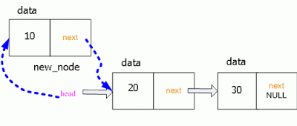
Inserting a Node to the Head of a List
// Inserts the node x to the head of a list. x has been created elsewhere
InsertListHead( L, x )
if head [L]= NULL //The list is empty
then head [L]← x
else
Next[x ] ← head [L]
head [L]← x
x
Notes:
42

Slide 43
Inserting a Node to the Tail of a List
Assume there is no tail pointer.
Informal algorithm: x is the node to be inserted to the tail
If the list is empty Make the new node the first node. Else Traverse the List to Find the last node. Add the new node to the end of the list.

Slide 44
Inserting a Node to the end of a List
//Inserts the new node x to the tail as the last node
InsertList( L, x )
current ← head [L]
if head [L] =NULL // List empty
then
head [L]← x
else
while next [current] ≠ NULL // Seach for the tail
do current ← next[current]
next[current] ← x // Now, current is the tail node
Notes:
44

Slide 45
Deleting a Node from a Linked List
To delete a node:
We locate the node that we want to delete (This has to be done seperately).
Change the pointers to disconnect this node.
Free the memory occupied by this node.
Notes:
45

Slide 46
Deleting a Node from a Linked List
In the diagrams, there are two external pointers namely curr and prev in addition to head whose data type is node*.
We must locate the address of the node to be deleted.
We need to change the pointer next in the node that preceeds the current node.
We set next so that it points the node that follows the current node. In C++
prev->next=curr->next;
Notes:
46

Slide 47
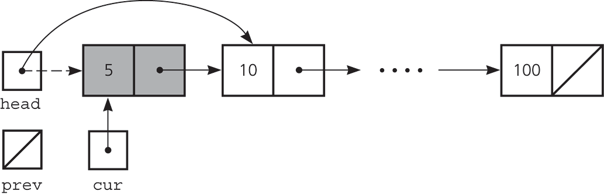
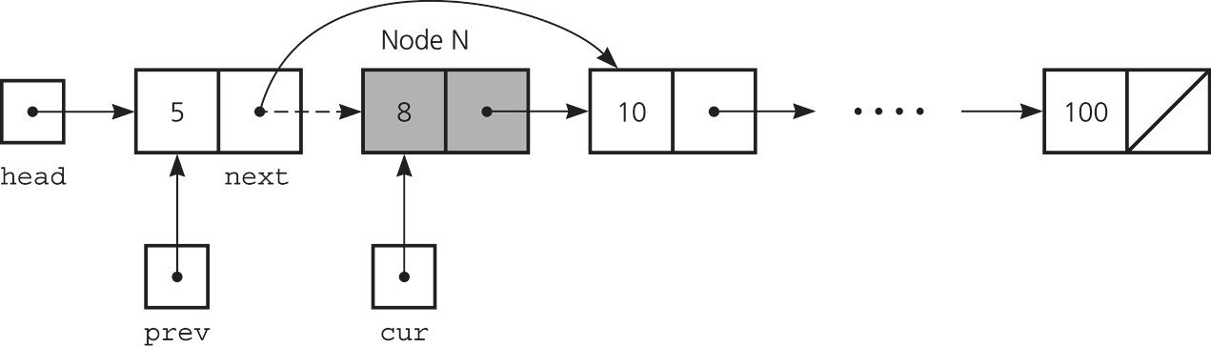
Deleting a Specified Node from a Linked List
Deleting the first node: head= next [cur]
Deleting an internal node: next[prev]= next[cur]

Slide 48
Deleting The Last Node
What happens if the last node is to be deleted?
The last node contains data value (item) 8. Delete this.
cur->next=NULL
prev
cur
head
item=5
item=9
.....
item=14
item=8
next
next
next
NULL
Notes:
48

Slide 49
Deleting a Node from a Linked List
Assume address of the node to be deleted is given as pointer x and prev represents the node just before x.
// Removes node x from the list L. x represents cur in the algorithm
LIST-DELETE(L,x)
if head [L] = x
then head [L] ← next [x] // C++ : head = x->next;
else
prev ← head [L]
while next[prev] ≠ x // Search for x
do
prev ← next [prev] // Move to next node until x
next[prev] ← next[x] // Update link of prev

Slide 50
Complexities of Linked List Operations
Running times of some list operations:
Add to head and add to tail: O(1) assuming tail pointer
Delete from head or tail: O(1), assuming tail pointer
Search for a node: Worst case O(n). We may have to traverse the entire list in the worst case.
Adding inside the list: O(n) if the position is not given (Worst case).
Delete a node: O(n), if the positon is not given (Worst case).
Average case complexities of last three are O(n/2) = O(n)
→If the position is given as a pointer , complexity is O(1)

Slide 51
Arrays or Linked Lists ?
Linked lists are more complex to code and manage than arrays, but they have some distinct advantages.
Dynamic: a linked list can easily grow and shrink in size.
We don’t need to know how many nodes will be in the list. They are created in memory at run time as needed.
In contrast, the size of an array is fixed at compilation time.
Easy and fast insertions and deletions
In an array updates are costly: we need to copy to temporary variables to make room for new elements or close the gap caused by deleted elements
→Several shift operations.
With a linked list, no need to move other nodes. Only need to reset some pointers.

Slide 52
Linked List Variations: Doubly Linked Lists
So far we have considered singly linked lists: Every node has one link field.
→ Singly linked lists allow only one-way traversal of the list
There are many important applications where singly linked list structures can not represent well the data and operations.
→We need more powerful list structures.
Frequently, we need to traverse a list in BOTH directions efficiently
Solution: Use a linked list structure where each node has two pointers:
1.Pointer to the successor (next) node
2.Pointer to the predecessor (previous) node.
Doubly Linked List nodes contain two link fields: next, prev

Slide 53
Doubly Liked List Structure
Any node of a doubly linked list can be used to start a new traversal of the list, in either direction
The head may have pointers to both ends of the list
Insert/delete operations in a doubly linked list require changing more links than the same operations on a singly linked list
Doubly Linked List.
forward traversal
head
x₁
next
x₂
x₃
x₄
prev
backward traversal

Slide 54
Doubly Linked List Node Declaration
struct DblListNode {
int data;
DblListNode *left, *right;
};
In the following example, the head includes links to both first and last nodes:
left
data
right
Head Node
Empty List
left
data
right
Head Node

Slide 55
Doubly Linked Lists: Complexity
All single node operations on a Doubly Linked List take constant time: O(1)
The only expensive part of operations is finding a specific node. Worst case complexity of search is the same as singly linked lists: O(n)
But once we find the relevant node, adding, removing, or accessing the data at that node takes only constant time.

Slide 56

Variations of Linked Lists: Circular Linked Lists
Sometimes we need to repeatedly go through the list from 1st node to last node, then continue from 1st node, and so on ….
Example: Allocate a shared resource to requesters without stopping
A circular list is one in which the last node points back to the first node.

Slide 57
Circular Linked Lists
Every node has a successor and no node contains NULL
→Last node points to the first node
We don’t use null to terminate a list. We also don’t need a head field to return to the first node: we can use the last link to find first node: Nodes form a ring
This makes it possible to continue traversing the list without stopping at the tail.

Slide 58
Circular Linked List: Example
first
BAT
CAT
EAT
FAT
GAT
HAT
first
rear
rear

Slide 59
Create the First Node and Circular List
Insert into an empty list. Node structure is the same as singly linked list node.
NodePtr* New = new Node;
New->data = 10;
Create the rear node:
Rear = New;
Rear->next = Rear;
Repeated insertions at the front
creates the circular list. But each time we have to link the rear node to the start of the list.
10
New
Rear

Slide 60
Circular Lists: Usage
Circular linked lists are useful for playing video and sound files in “looping” mode: Action continues without stopping.
Some examples:
Netflix movie browsing interface or the Facebook album gallery: Users are able to scroll through a number of list items continuously, looping back to the beginning when they reach the end of the list.
Picture gallery displays on most web sites usually loop back to the beginning continually.

Slide 61
Circular Lists: Usage
Personal Computers : All the running applications are kept in a circular linked list and the OS gives a fixed time slot to all running applications.
The Operating System keeps on traversing the linked list until all the applications are completed.
Multiplayer game programming: All the Players are kept in a Circular Linked List and the pointer moves forward as a player's chance ends.

Slide 62
Complexity of Circular List Operations
Essentially similar to other list implementations
Complexity of accessing any node using a given address is O(1)
Even if only a tail pointer is used, both the first and the last list elements can be found in constant time: O(1)
The disadvantage is that the algorithms are more detailed.

Slide 63
Linked List Applications
Dynamic Stacks and Queues
Large Integer Arithmetic

Slide 64
C++ implementation of linked lists: Example-1 Building the list {1, 2, 3}
Suppose we want to write a simple function which uses pointer operations to build the list {1, 2, 3}.
→Build the list {1, 2, 3} and store its head pointer in a local variable.
→Return the head pointer to the caller.
Node structure declaration:
struct node
{
int data;
node *next;
};
Notes:
64

Slide 65
C++ implementation of linked lists: Example-1 Building the list {1, 2, 3}
void BuildOneTwoThree() {
node *head, *second * third; //Declare 3 node pointers
// allocate 3 nodes
head = new node;
second = new node;
third = new node;
//Continues on next slide
Notes:
65

Slide 66
C++ implementation of linked lists: Example-1 Building the list {1, 2, 3}
head->data = 1; // setup head as first node
head->next = second; // pointer assignment
second->data = 2; // setup second node
second->next = third;
third->data = 3; // setup third link
third->next = NULL;
// At this point, the linked list is referenced by "head“
return head;
};
Notes:
66

Slide 67
C++ implementation of linked lists: Example-2 Return the number of nodes in the list
/*Given a linked list head pointer, compute and return the number of nodes in the list.*/
int Length (node* head) {
node* current = new node;
current = head;
int count = 0;
while (current != NULL) {
count++;
current = current->next;
}
return count;
}
Notes:
67

Slide 68
C++ implementation of linked lists: Example -3
Add a node at the end of the list
//Head is the first node, it contains data
#include <iostream>
using namespace std;
struct Node
{
int data;
Node* next;
};
// only for the 1st Node
void firstNode(struct Node *head, int n)
{
head->data = n;
head->next =NULL;
}

Slide 69
C++ implementation of linked lists: Example -3
Add a node at the end of the list
// Inserts to the tail by search
void addNode(struct Node *head, int n)
{
Node *newNode = new Node;
newNode->data = n;
newNode->next = NULL;
Node *cur = new Node;
cur = head;
while(cur) {
if(cur->next == NULL) {
cur->next = newNode;
return;
}
cur = cur->next; //else
}
}

Slide 70
LL Applications: Dynamic Stacks
We can implement a stack with a singly linked list
Advantage:
The stack can grow/shrink dynamically
Basic implementation
The list is initially empty
The top element of the stack is the first node of the list
push() method adds a new item as the new first node of the list
pop() method removes the first node of the list
Does this implementation keep the LIFO order?

Slide 71
Stack with a Singly Linked List
New nodes should be inserted only at the front of the list, so that they become the top of the stack
Nodes are also removed only from the front (top) of the list
nodes
Top
/
elements

Slide 72
Linked Stack: Advantages
A linked list-based stack offers two advantages over an array-based stack.
No need to specify the starting size of the stack. A dynamic stack simply starts as an empty linked list, and then expands by one node each time a value is pushed.
A dynamic stack will never be full, as long as the system has enough free memory.

Slide 73
Linked Stack Example
st:stack
st.push(6):Insert to empty list
st.push(1):Insert 1 to front
st.push(7):Insert 7 to front
st.push(8):Insert 8 to front
st.pop(): Delete from front
8
top
7
1
6

Slide 74
LL Applications: Dynamic Queues
A linked list can also be used to implement a queue, but we must maintain both a front and a rear pointer
A dynamic queue starts as an empty linked list.
With the first enqueue operation, a node is added, which is pointed to by front and rear pointers.
As each new item is added to the queue, a new node is added to the rear of the list, and the rear pointer is updated to point to the new node.
As each item is dequeued, the node pointed to by the front pointer is deleted, and front is made to point to the next node in the list.

Slide 75
Implementing a Dynamic Queue
We use a linked list with both a head and a tail pointer.
The head ptr points to the front of the list.
The tail ptr points to the rear of the list.
Advantage: As the size of the linked list is not fixed, the queue is NEVER full.
13
15
10
front
7
null
head_ptr
rear

Slide 76
Linked Queues: Operations
Empty Queue
Front
/
Rear
Enqueue x
Front
x
/
Rear
Enqueue y
Front
x
y
/
Rear
Dequeue x
Front
y
/
Rear

Slide 77
Complexities of Linked Queue Operations
Queue using an underlying linked list:
As long as we have both a head and a tail pointer in the linked list, all operations are O(1)
important: enqueue() should use addTail()
dequeue() should use removeHead()
Why not the other way around?
No need for the list to be doubly-linked

Slide 78
LL Applications: Arithmetic with Large Integers
The range of integer values varies from one computer to another.
For long integers, the range is typically : -2³¹ to 2³¹-1
[-2,147,483,648 to 2,147,483,647]
An integer outside this range can not be stored.
How can we represent and manipulate large integers that are outside the allowable range?
Solution: Use a linked list where each node holds a decimal digit of the integer.
[Note : Sizes of primitive data types in bytes:
Size of char : 1 Size of int : 4 Size of short int : 2 Size of long int : 4 Size of float : 4 Size of double : 8 ]

Slide 79
Arithmetic with Large Integers
Create a linked list for every integer where data fields of nodes contain decimal digits of the number.
If we represent integers this way, there would be no limit to representing any number.
We can then perform standard arithmetic on the linked list nodes. The result of an operation can be stored in another list.

Slide 80
Arithmetic with Large Integers: Sum
Example:
First number = 12345,
Second number = 56789
First list: 1->2->3->4->5->NULL
Second list: 5->6->7->8->9->NULL
Resulting list should be:
6->9->1->3->4->NULL

Slide 81
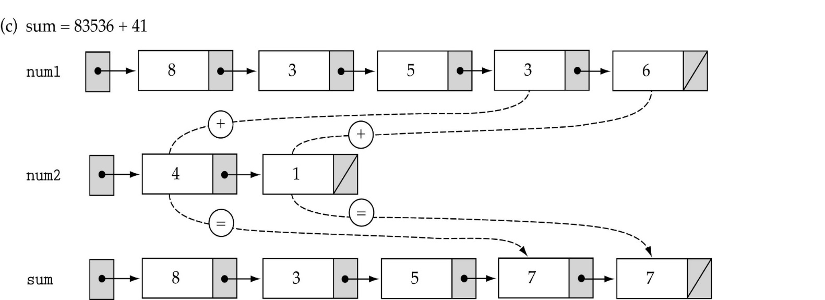
Operations with Large Integers Example: To save space the example does not use large integers. However, the method works for any size → Arbitrary precision arithmetic.

Slide 82
LL Applications: Operations with Polynomials
Representing a polynomial using a linked lists: List nodes include two data fields: 1.Coefficient 2.power. Create a linked list for each polynomial.
Example: Adding two polynomials :
P = 15+10x⁵⁰+3x¹²⁰⁰
p
15
0
10
50
3
1200
Q =5+30x⁵⁰+4x¹⁰⁰
q
5
0
30
50
4
100
Find P+Q (or P-Q)

Slide 83
Addition of Polynomials
Create a result list r (= P+Q) .
Perform one pass down each list and add corresponding data field values and insert into r:
P=15+10x⁵⁰+3x¹²⁰⁰
p
15
0
10
50
3
1200
Q=5+30x⁵⁰+4x¹⁰⁰
q
5
0
30
50
4
100
r
20
0
40
50
4
100
3
1200
R = 20+40x⁵⁰+4x¹⁰⁰ +3x¹²⁰⁰

